Slide 1
AEC Blockstarter 4.0 (4.2) – Group A
Patrick Friedrich, Morgan K. Geldenhuys, Jan Kalkan, Dennis Meyer, Marc Ottenbacher, Thanh Tuan Tenh Cong, Johnny Tran, Janis von Bleichert | ISE | Blockstarter 4.0

Slide 2







Motivation

Slide 3
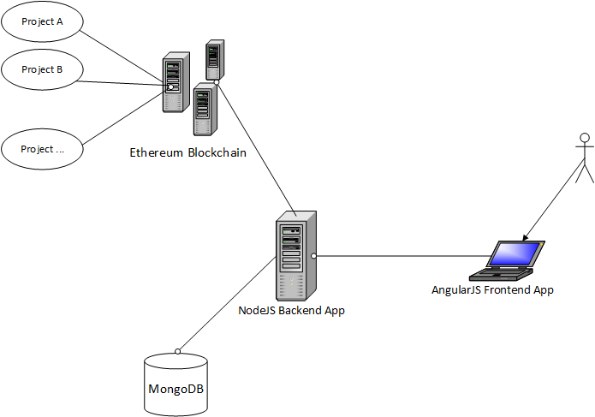
Architecture

Slide 4
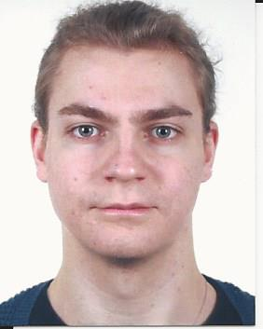
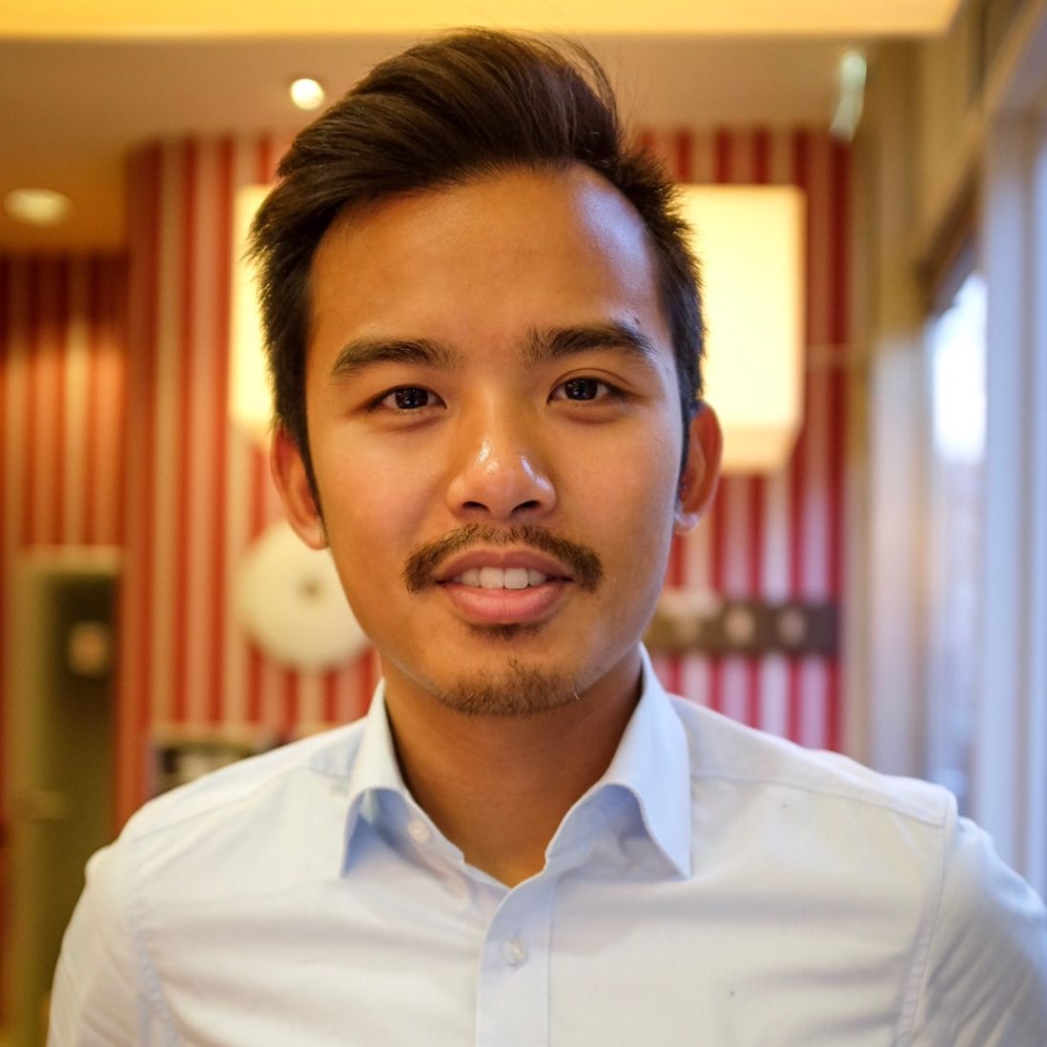





Team and Task Division
Patrick
Johnny
Janis
Thanh
Morgan
Marc
Jan
Dennis

Slide 5
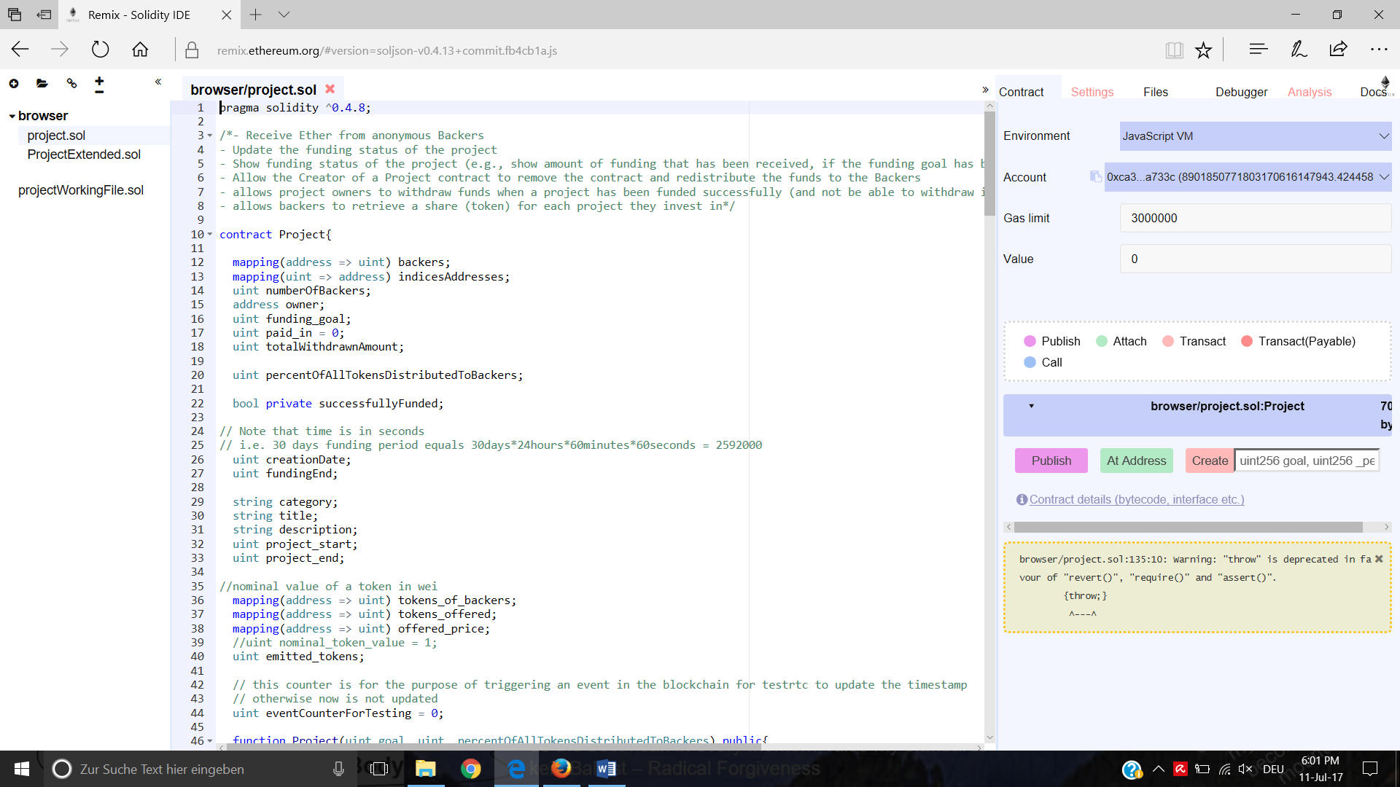

Smart Contract(s)
Language: Solidity
IDE: Remix
Testing: Remix, Postman, with Frontend GUI
Base Implementation: create, kill, invest, getter methods (e.g. Token Share)
Extensions: Funding Deadline, Trade Tokens, Voting on Issues

Slide 6
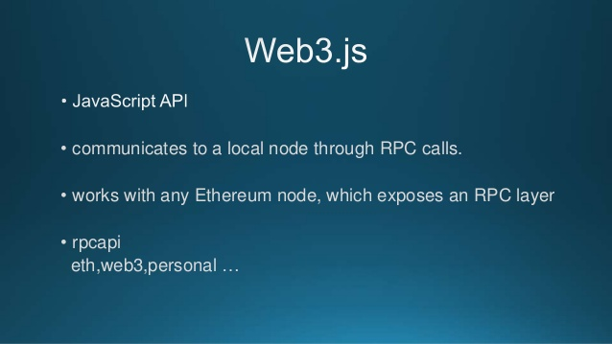
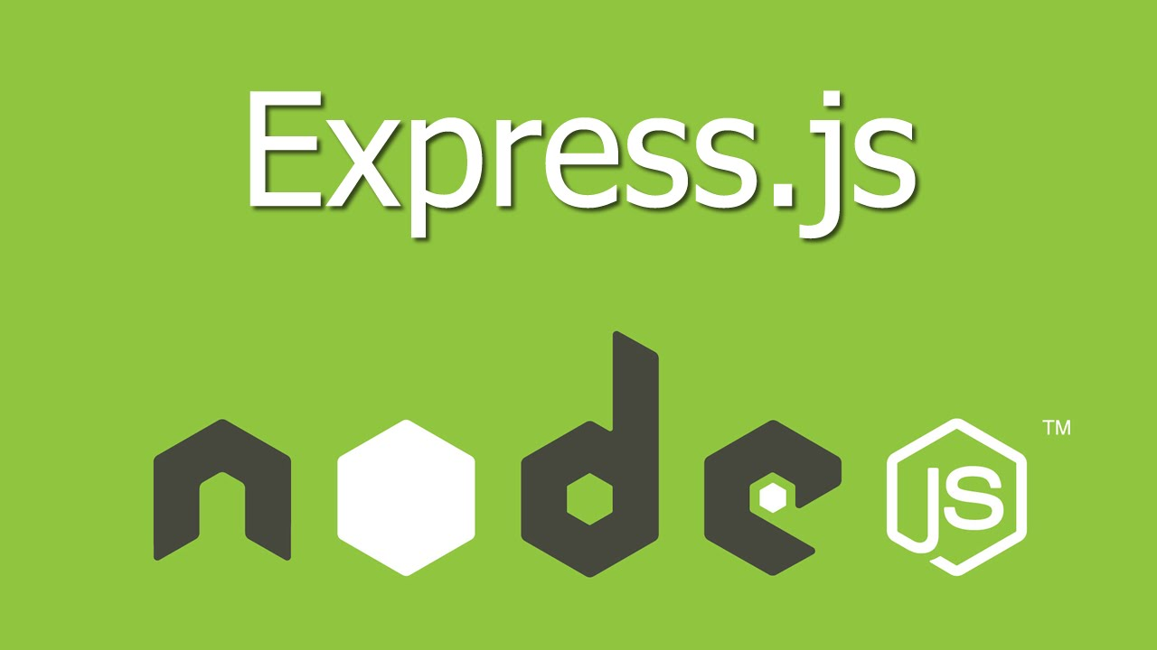

Backend (1/2)
Technologies: Node.js, Express.js, MongoDB, Mongoose, Web3.js
Testing: Postman, with Frontend GUI
Data models: user, project, contract
Provides: Routes (REST API)

Slide 7
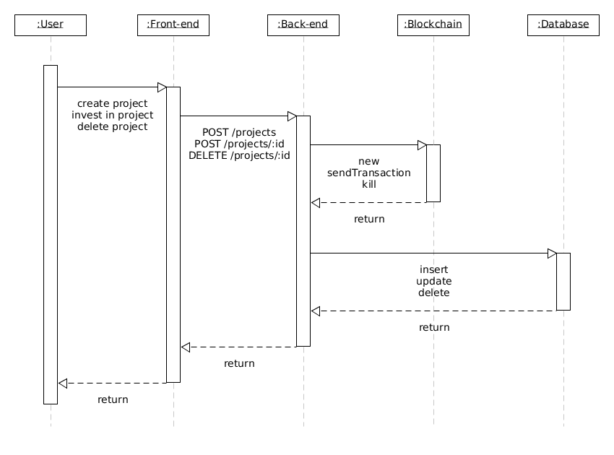
Backend (2/2) - Base Project Transactions

Slide 8
Frontend
¡Demo!

Slide 9

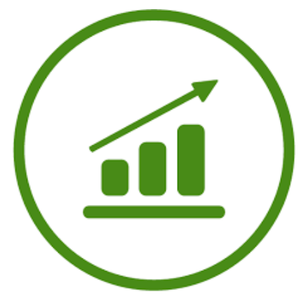
Strong Points & Potential Next Development Steps
All Functionalities of Crowdfunding platform
Synchronization MongoDB & Blockchain
Fast Response Times for User
Distributed Backend Environment
Voting Functionality into Application

Slide 10
Q & A

Slide 11
Thank You

